Slide 1
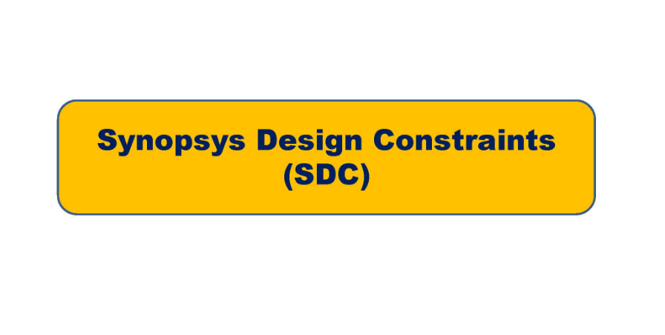

Slide 2
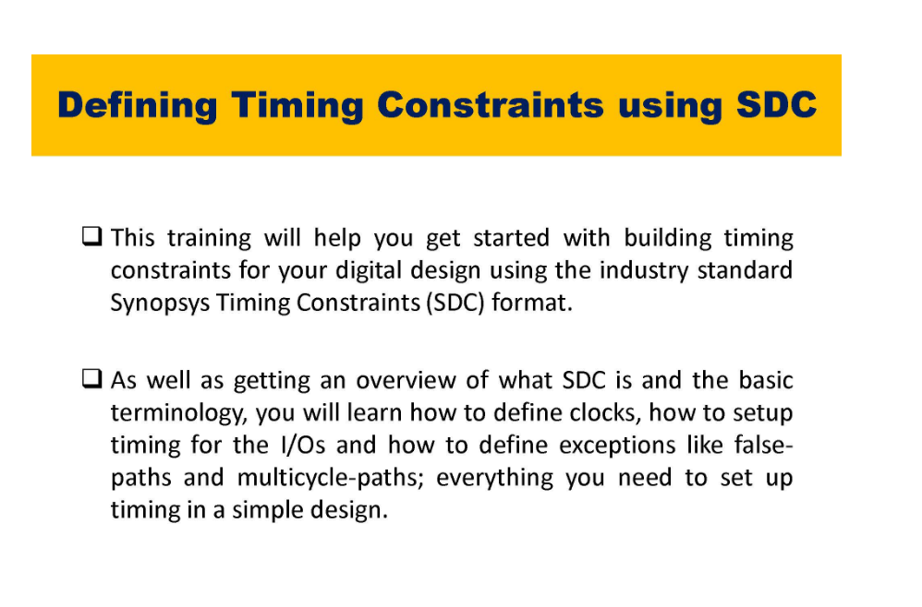

Slide 3
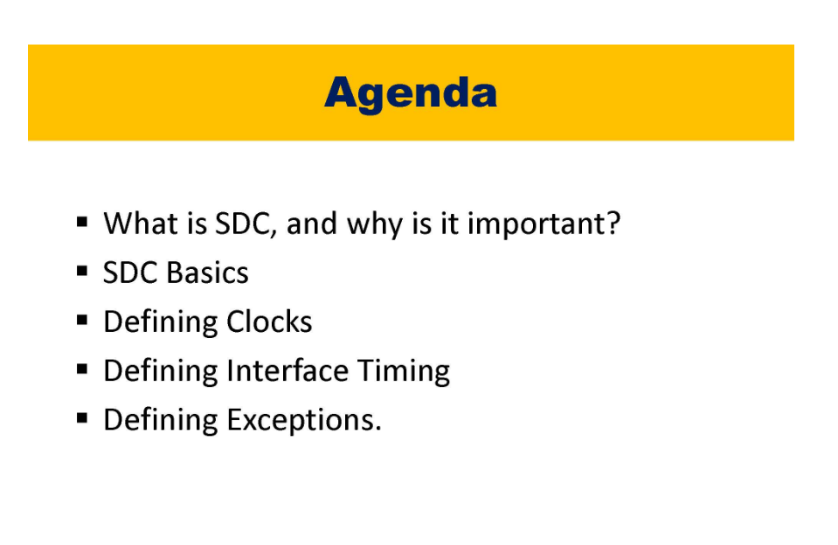

Slide 4
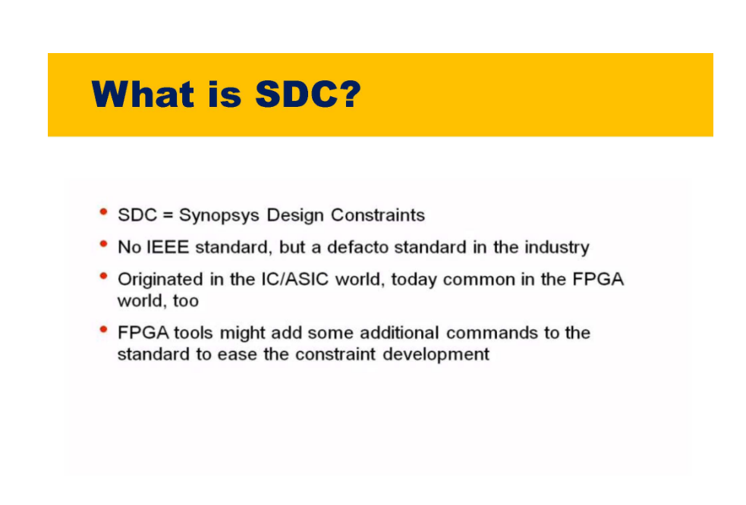

Slide 6
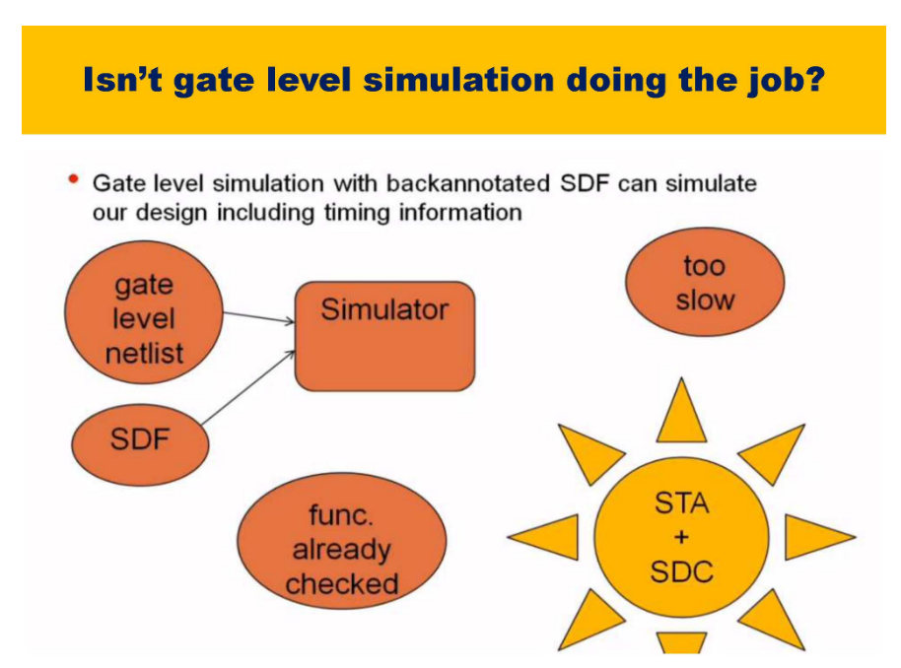

Slide 7
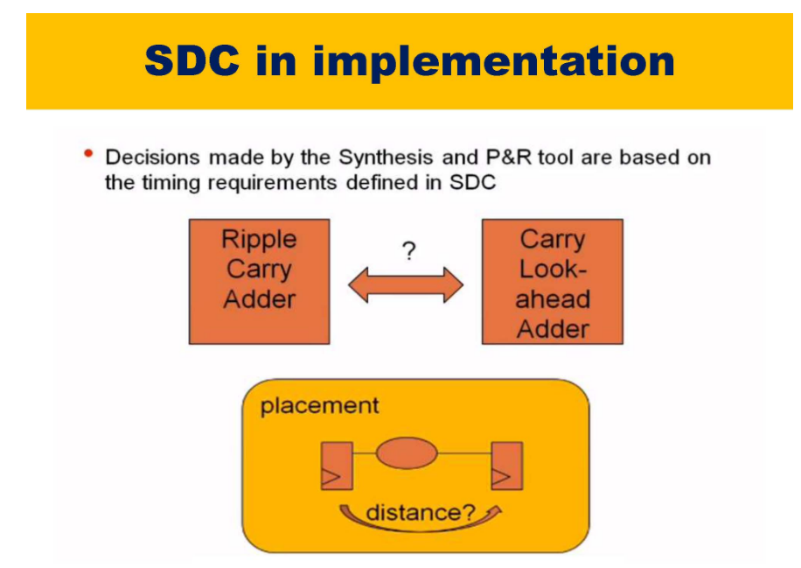

Slide 8
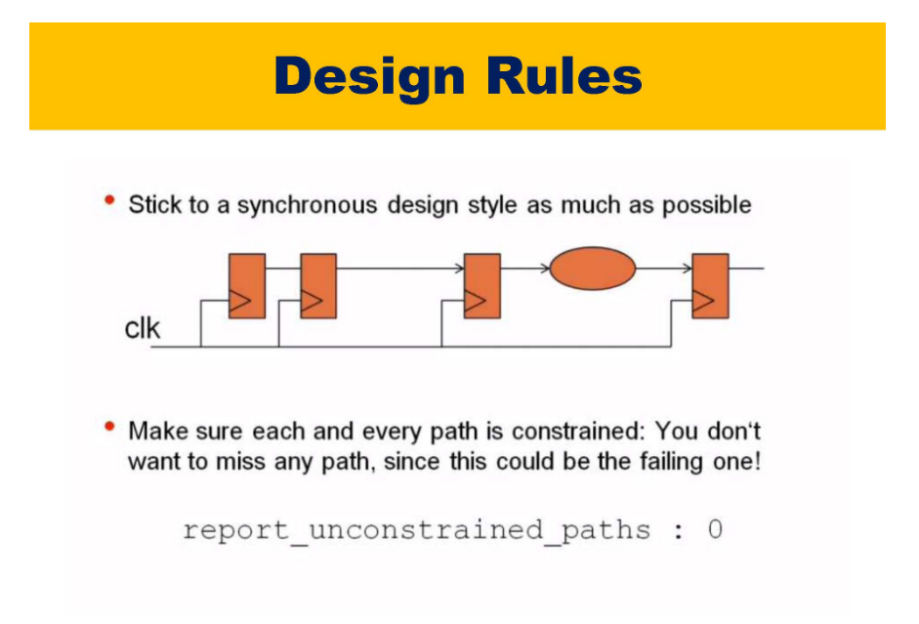

Slide 9
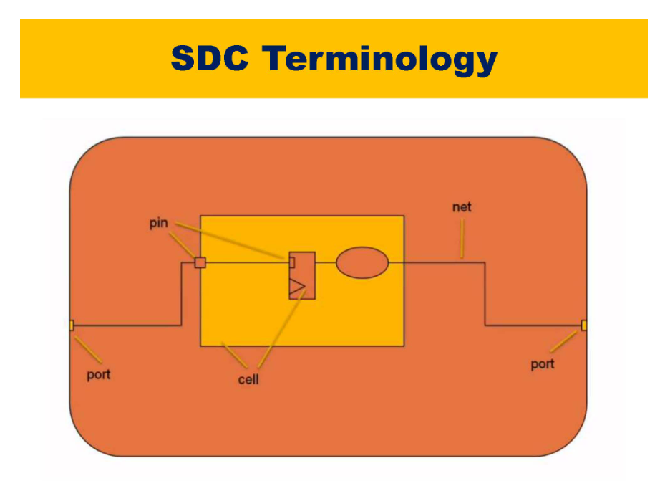

Slide 10
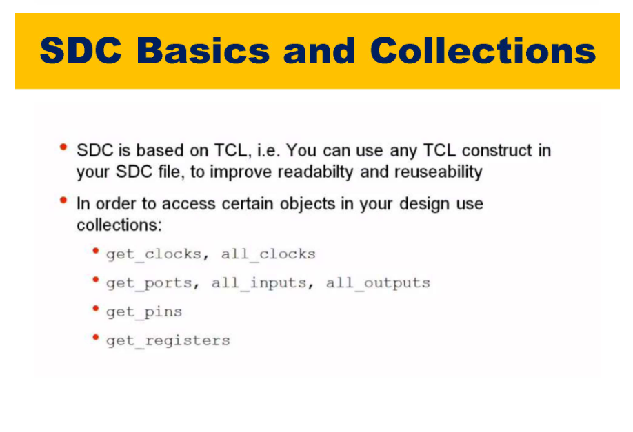

Slide 11
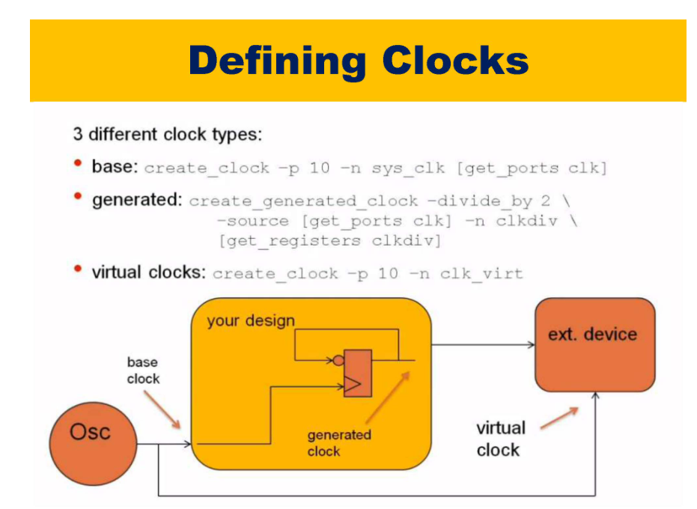

Slide 12
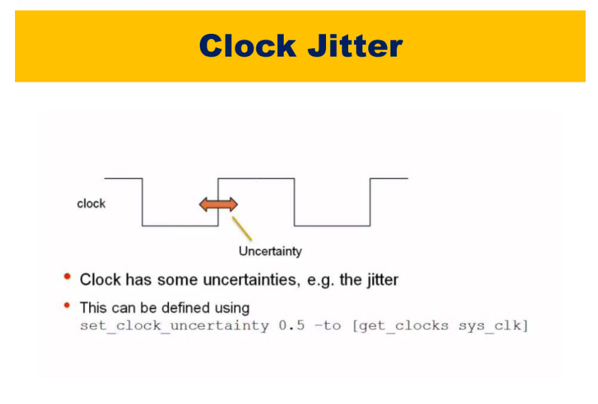

Slide 13
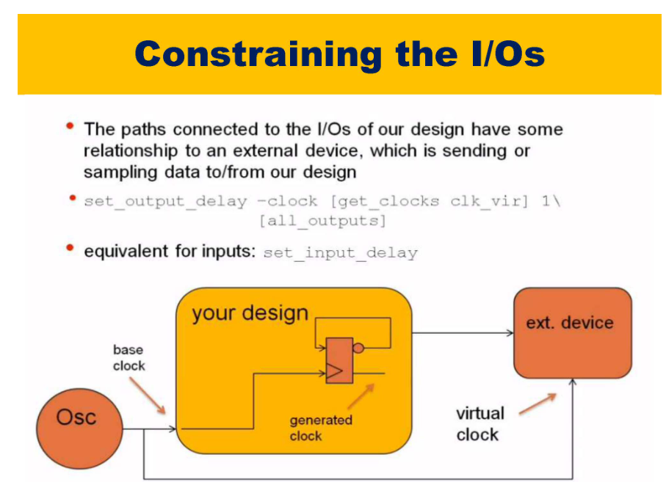
In synthesis we take care of only setup violations because it is related to clock
All asynchronous clocks are false clocks, async clocks will go to metastability and we are taking care of that in CDC
False and Multi paths are required because they reduce time
Asysnchronous clocks are analyzed during CDC and Synchronous clocks are analyzed during timing analysis
setup and hold time with those delays during synthesis
feedthrough paths means it is directly connected hence no comb logic in between

Slide 14
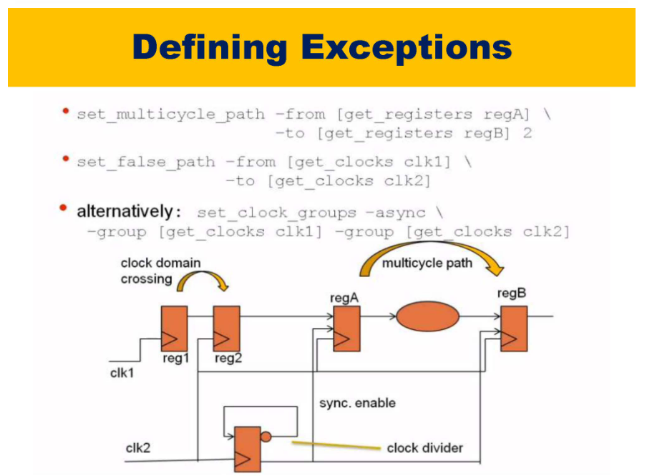

Slide 15
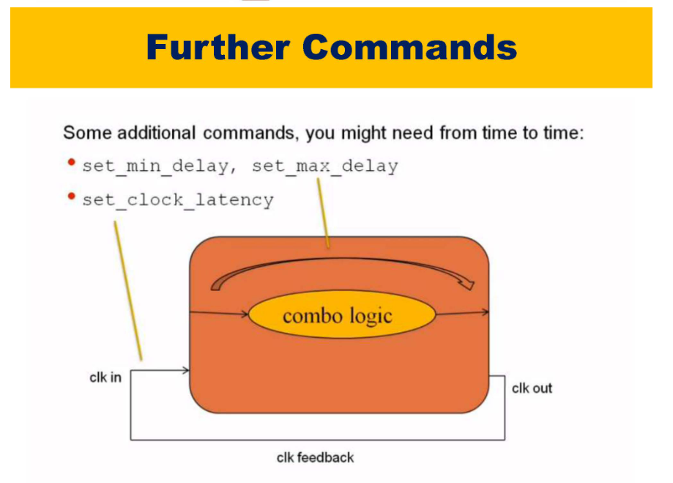

Slide 16
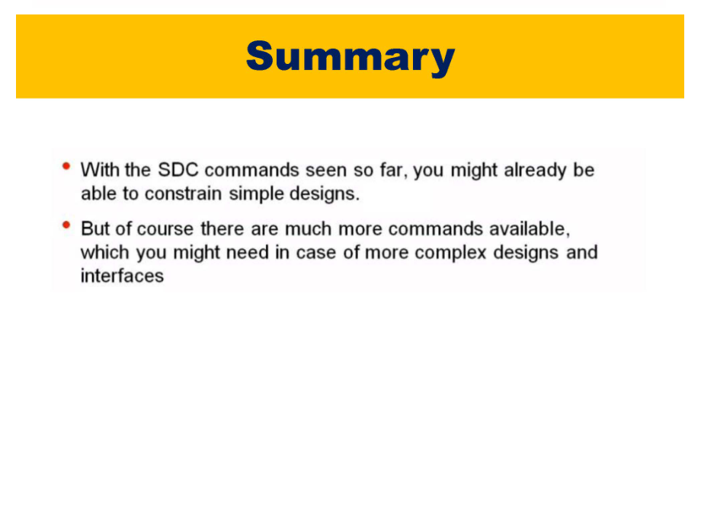

Slide 17
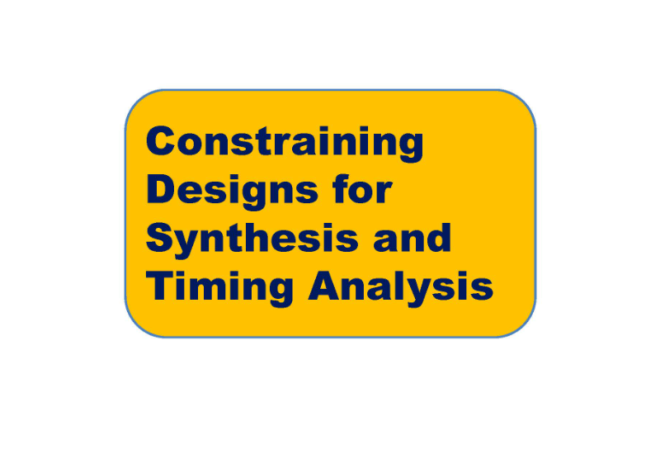

Slide 18
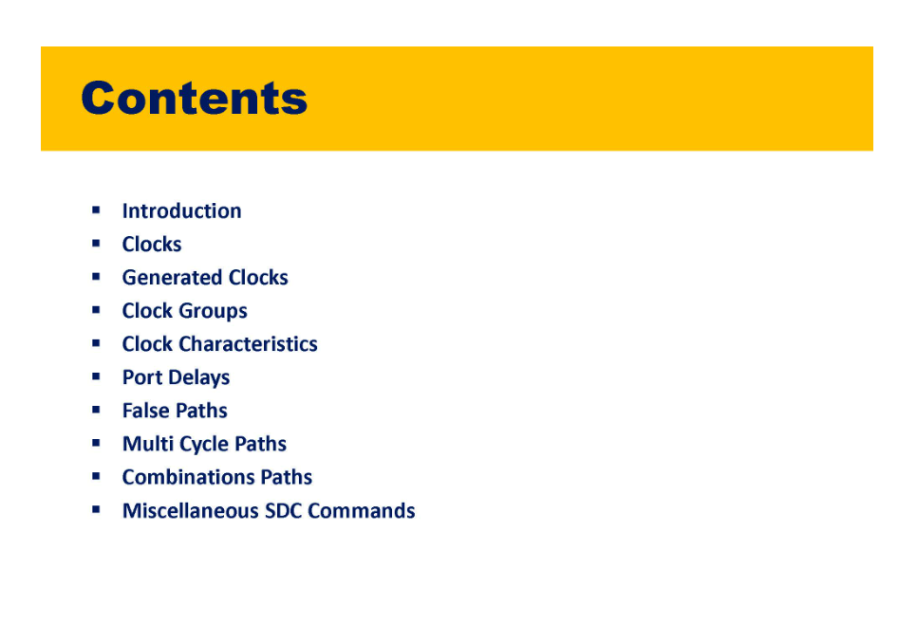

Slide 19
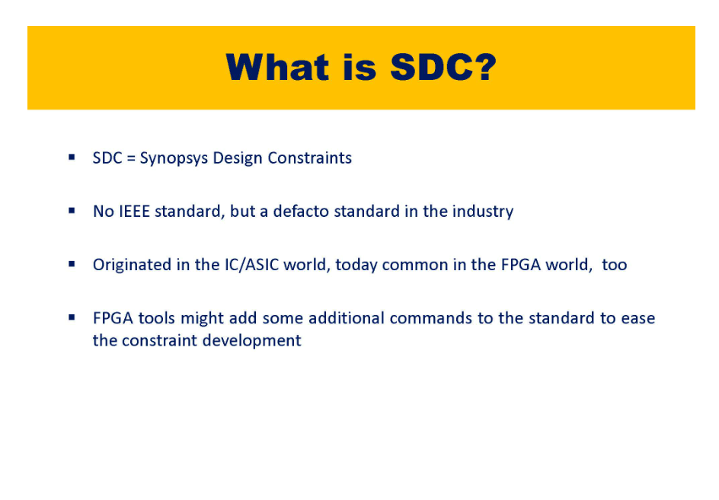

Slide 20
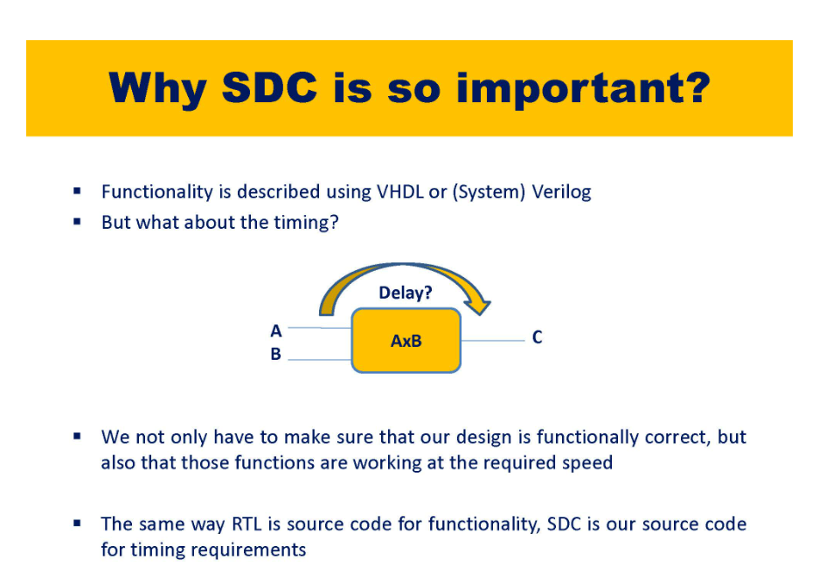

Slide 21
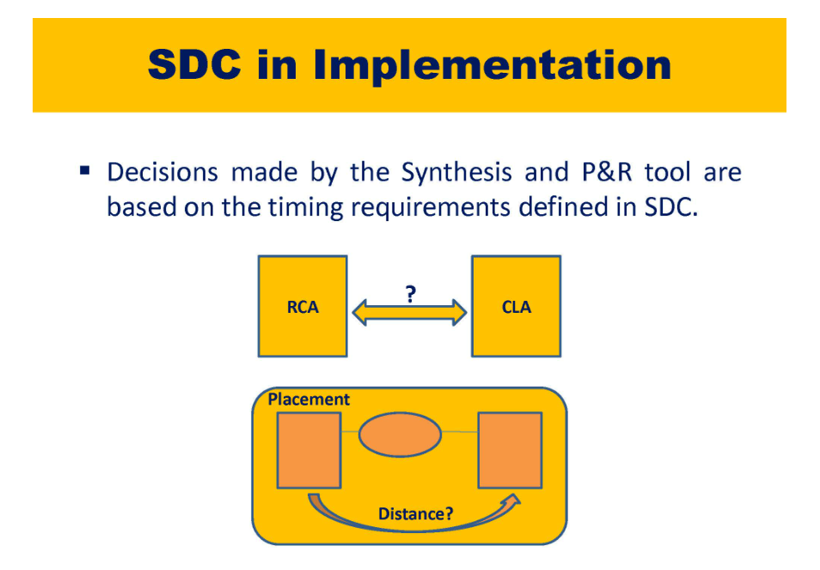

Slide 22
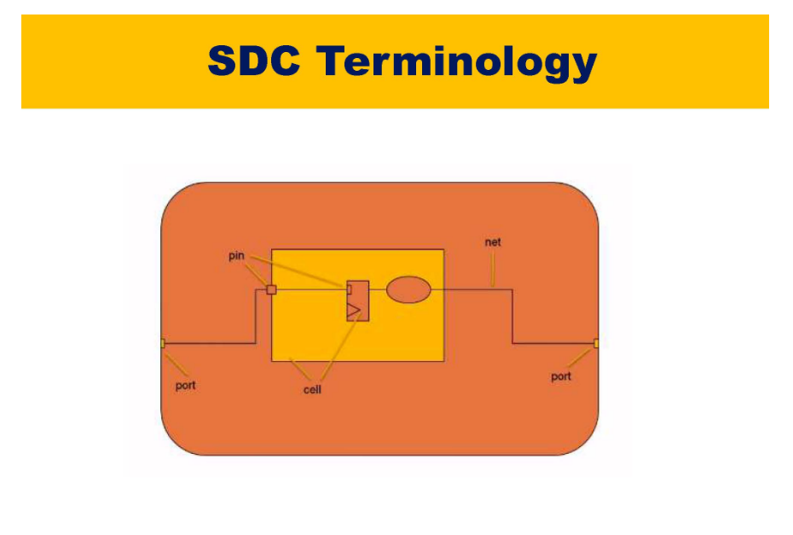

Slide 23
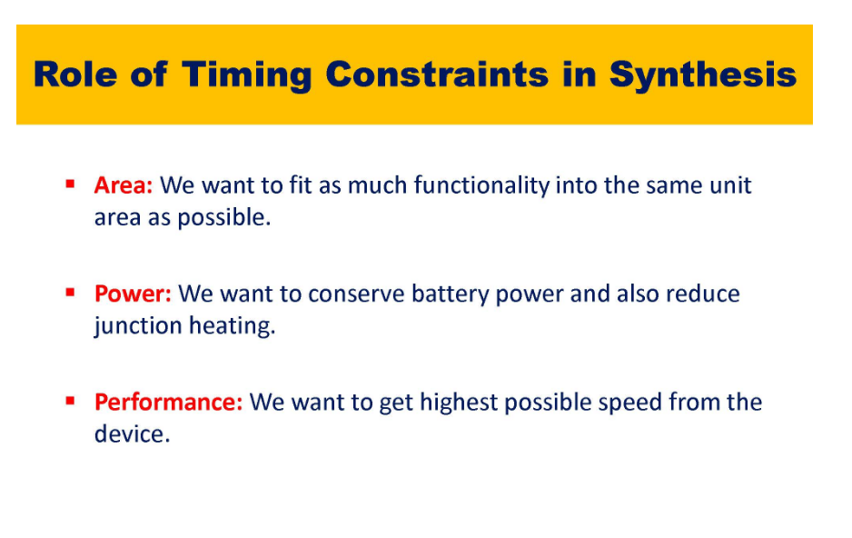
Which adder to use for area, timing power, performance
In your constraints SDC you have to tell what is the priority
Now the synthesis/PnR tools will try to optimize the path as per the design constraints hence it will select ripple carry adder (more delay) or carry look ahead adder(less delay) based on your constraints (or priority) SDC file

Slide 24
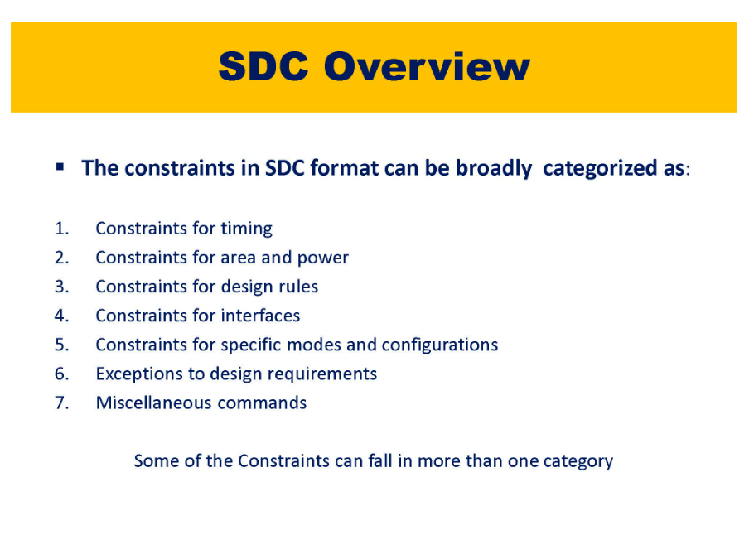

Slide 25
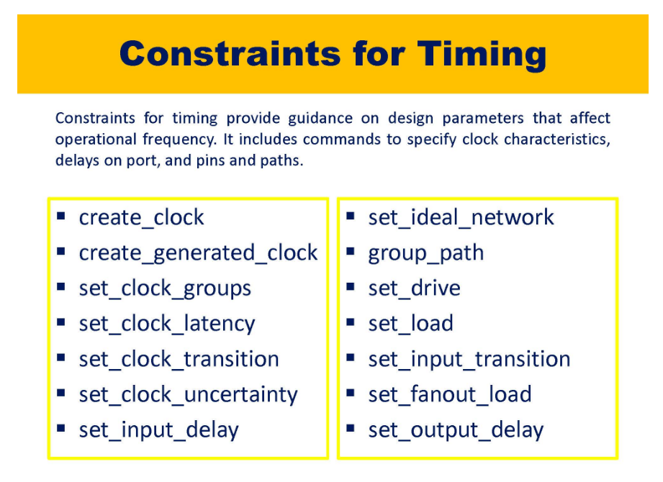
set_clock_groups -async means it won't analyze from clk1 to clk2 and clk2 to clk1

Slide 26
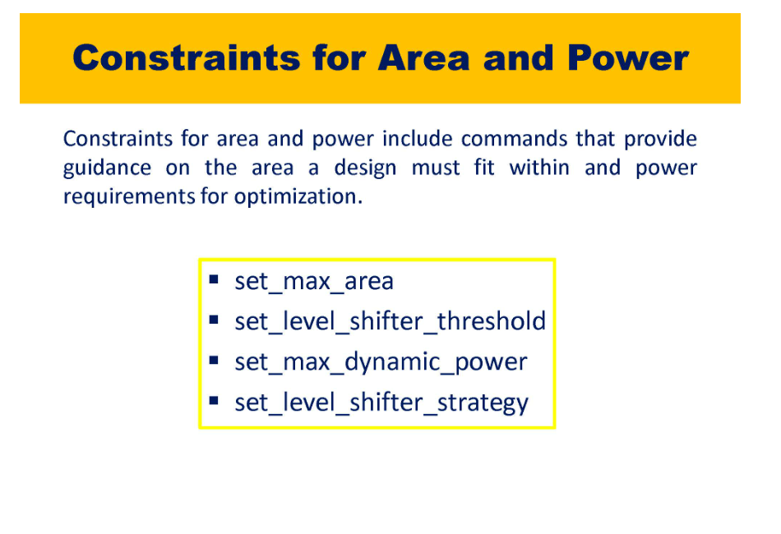

Slide 27
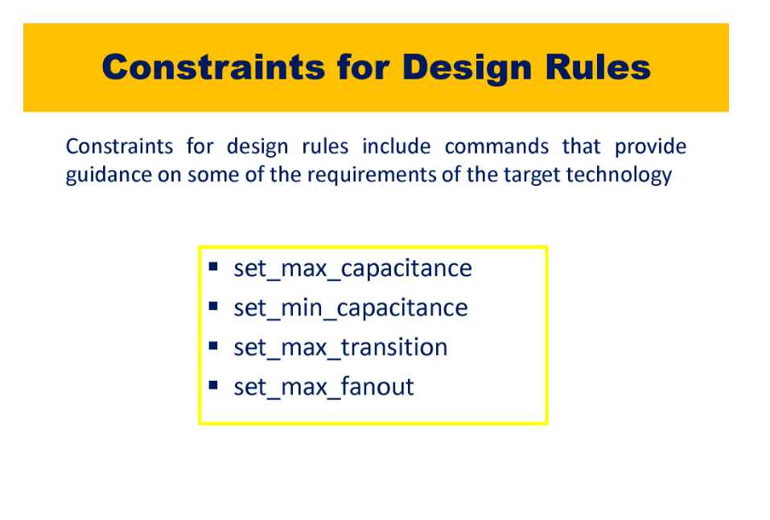

Slide 28
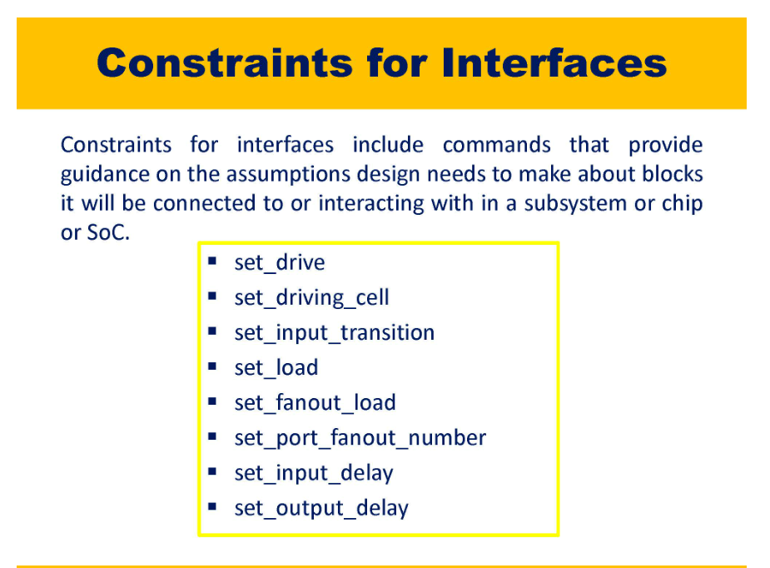

Slide 29
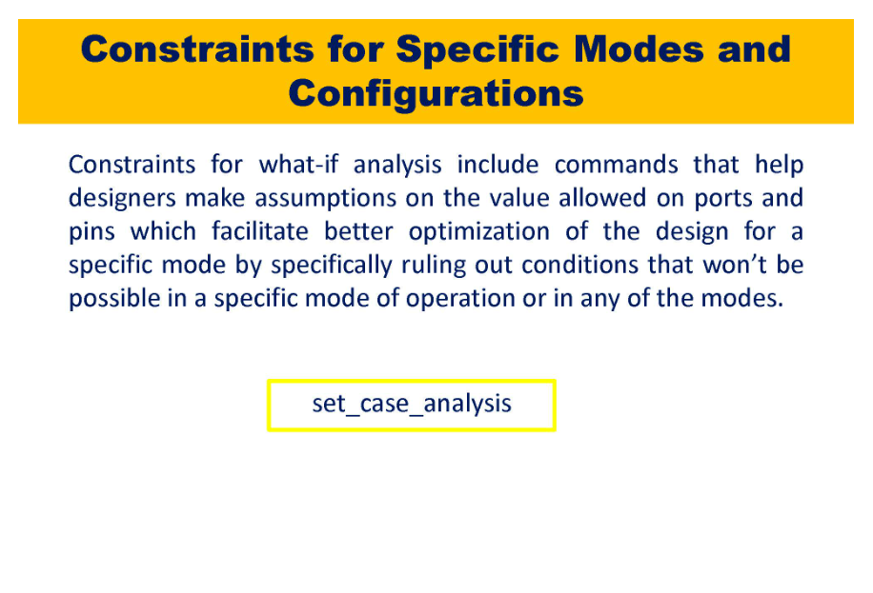

Slide 30
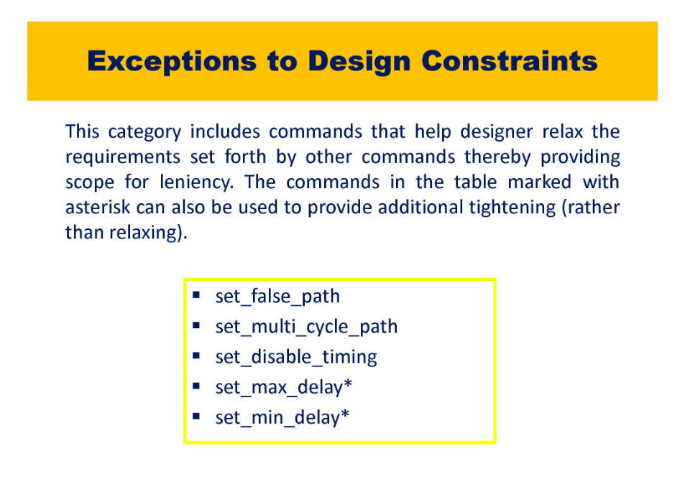
set_min_delay and set_max_delay is required to optimize the combinational logic in such a way that it meets

Slide 31
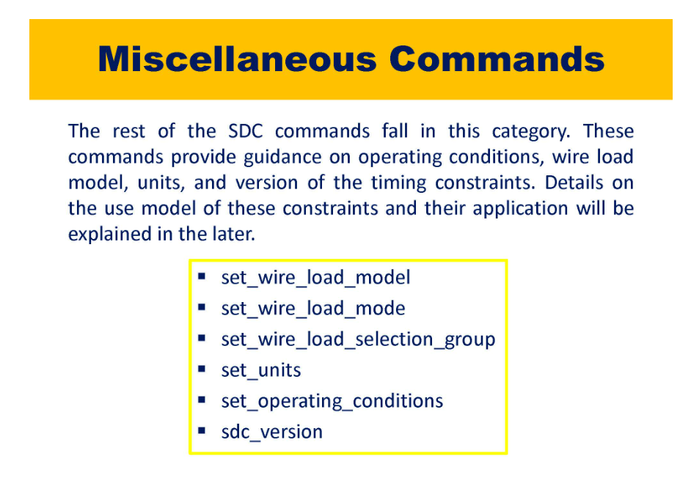

Slide 32
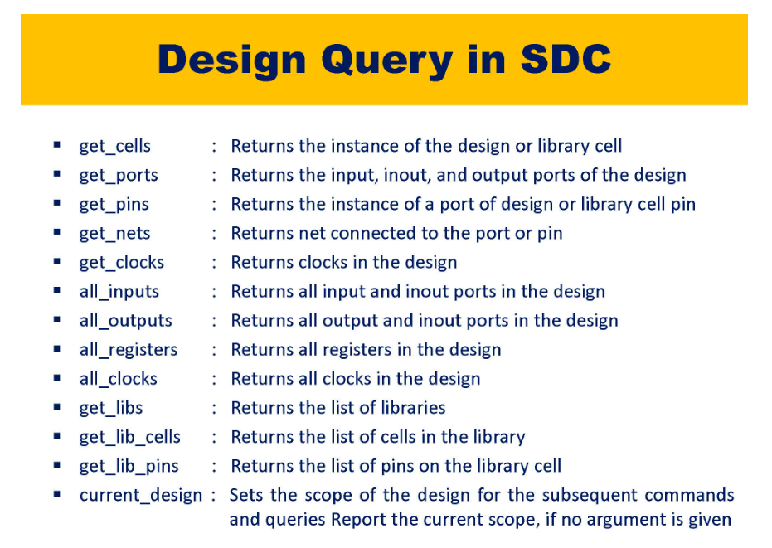

Slide 33
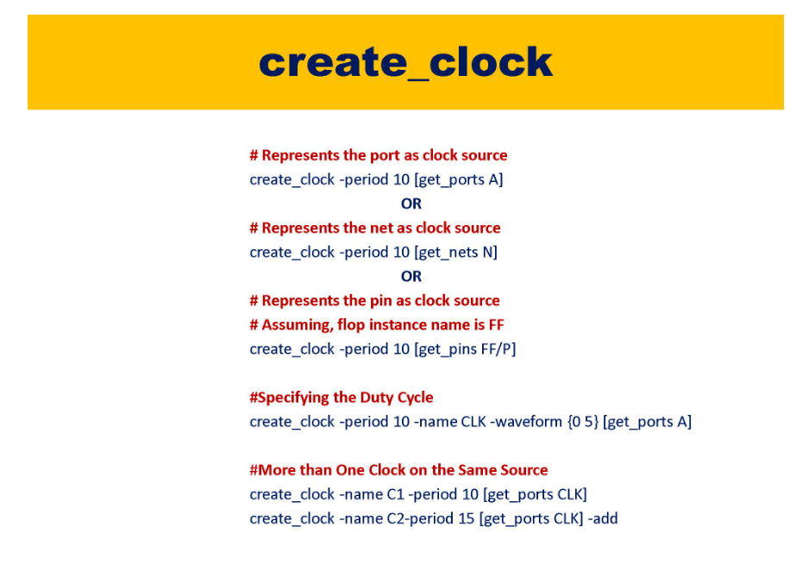

Slide 34
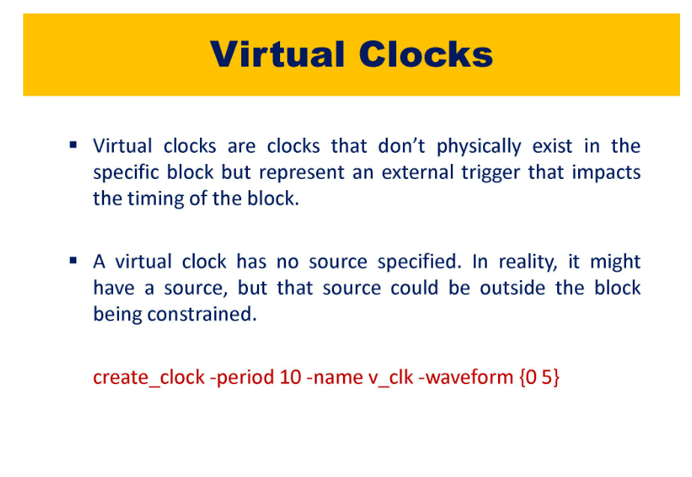

Slide 35
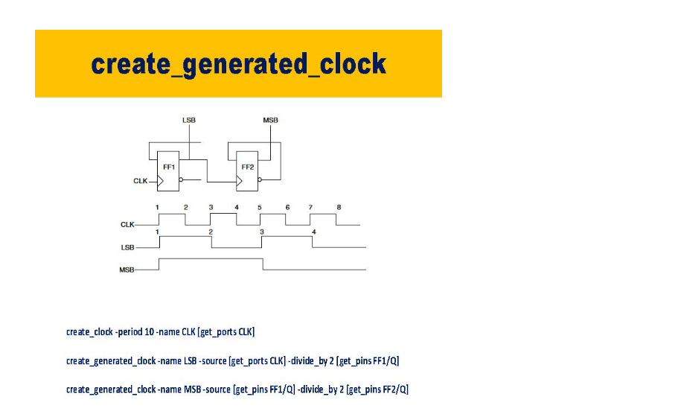
Generated clocks are clock multiplier, clock dividers and clock gating

Slide 36
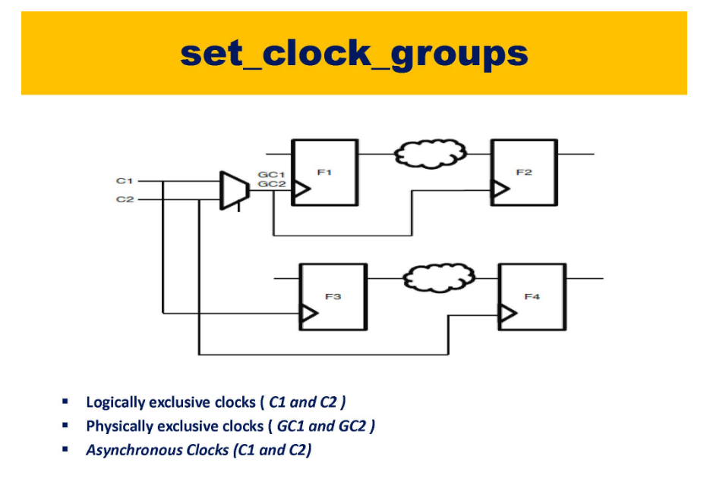

Slide 37
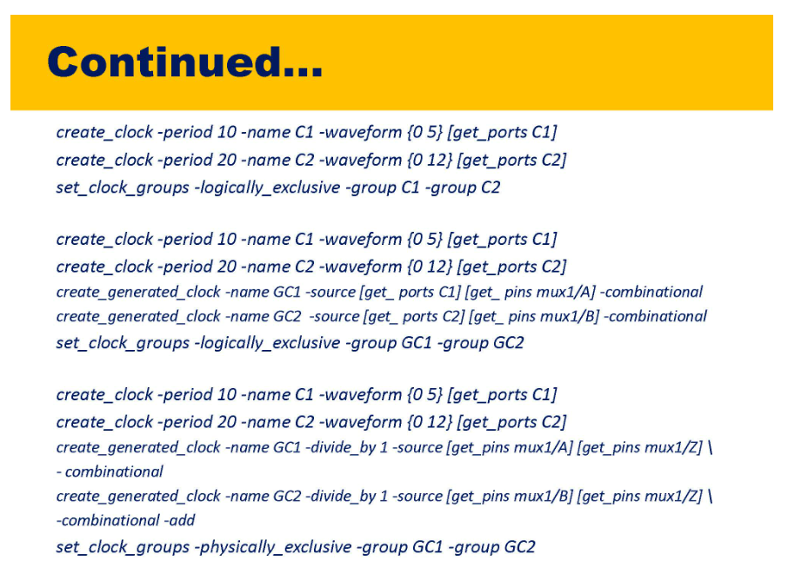

Slide 38
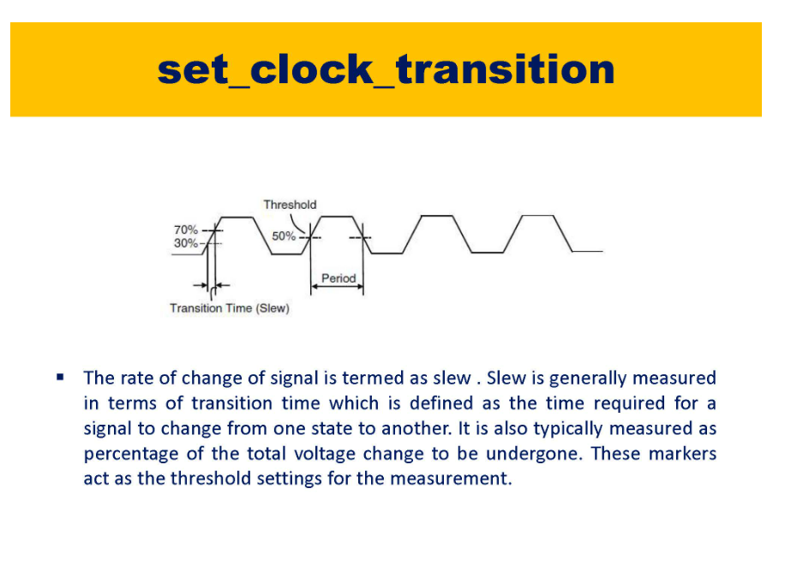

Slide 39
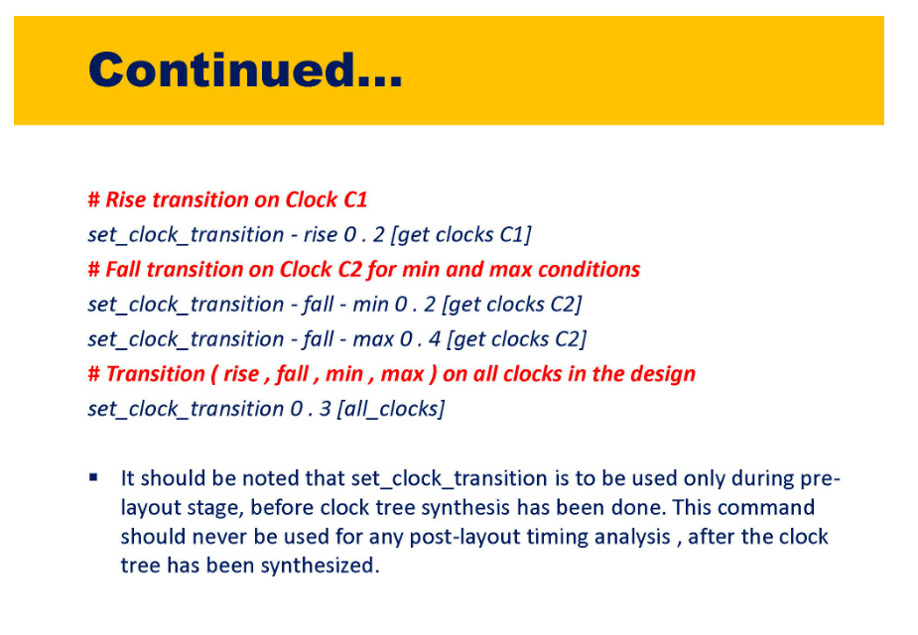

Slide 40
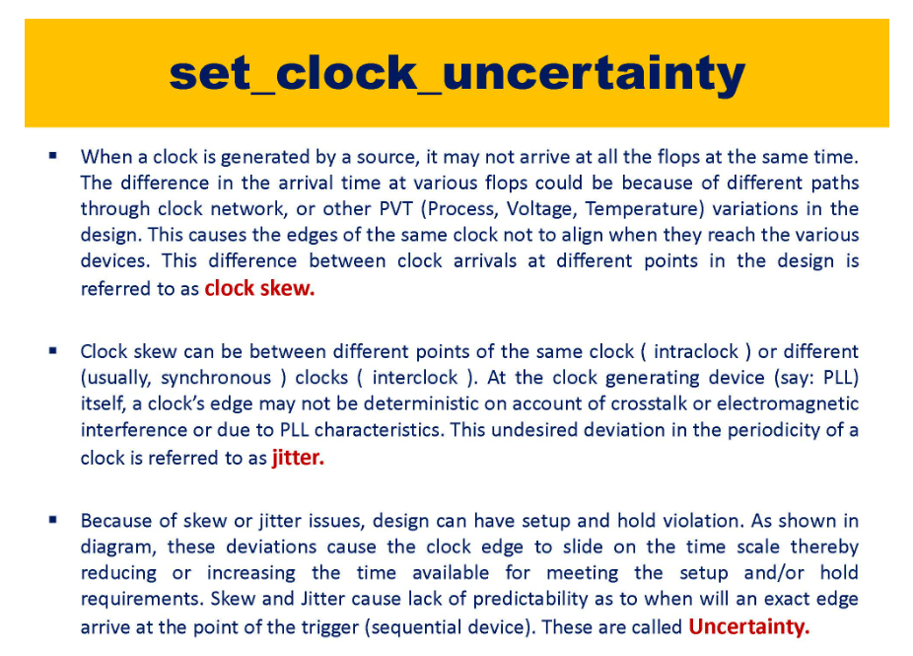

Slide 41
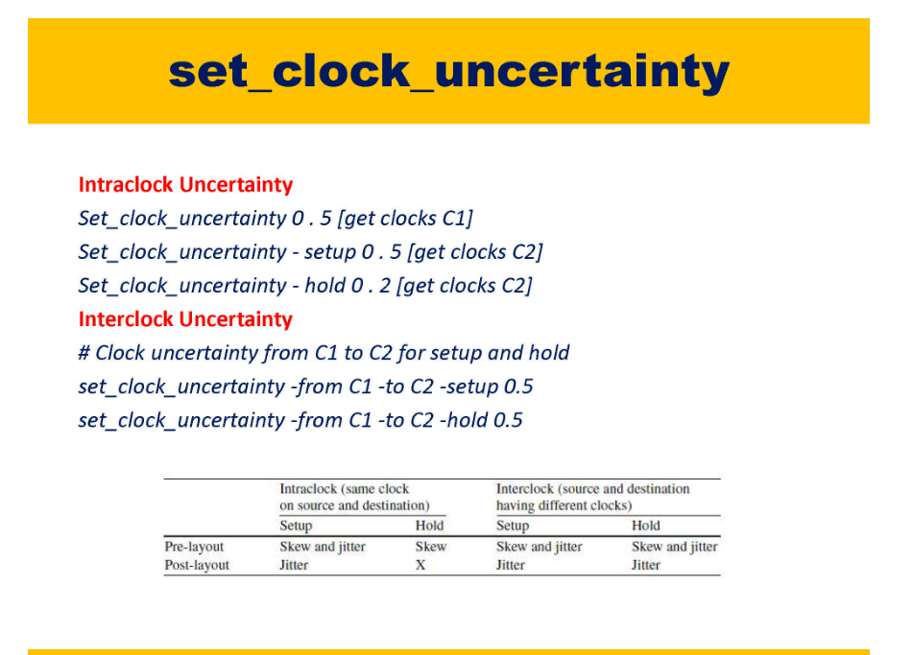

Slide 42
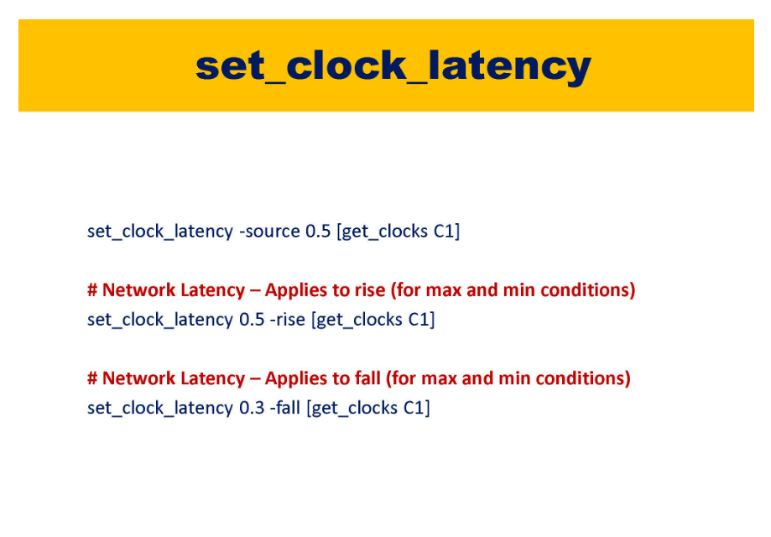

Slide 43
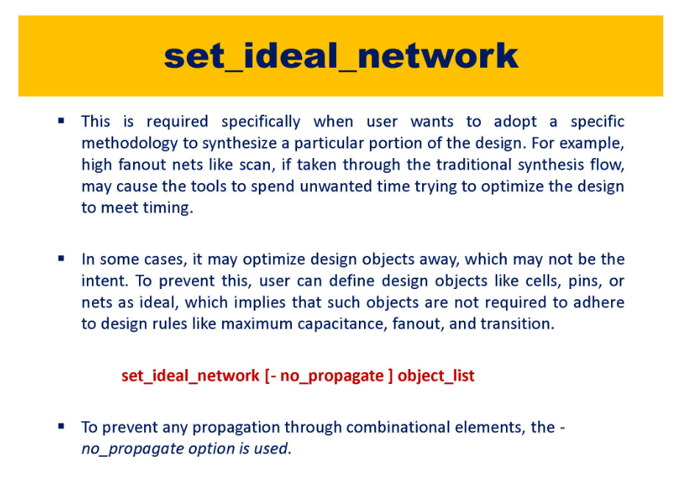

Slide 44
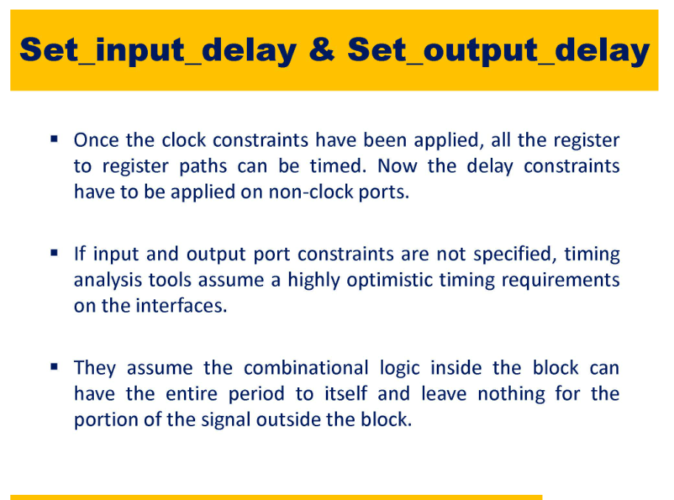

Slide 45
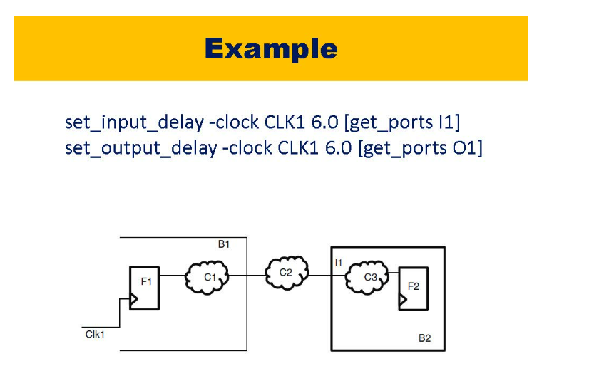

Slide 46
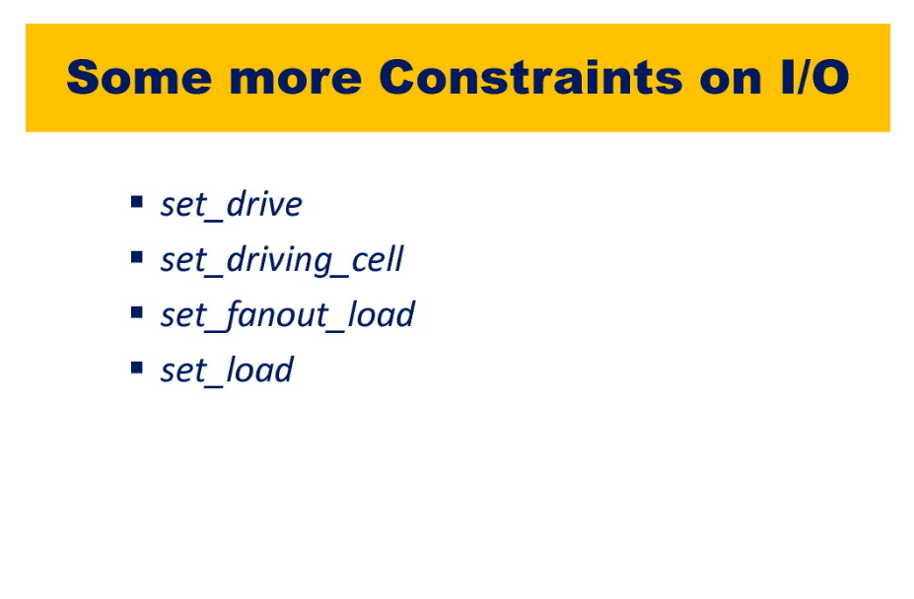

Slide 47
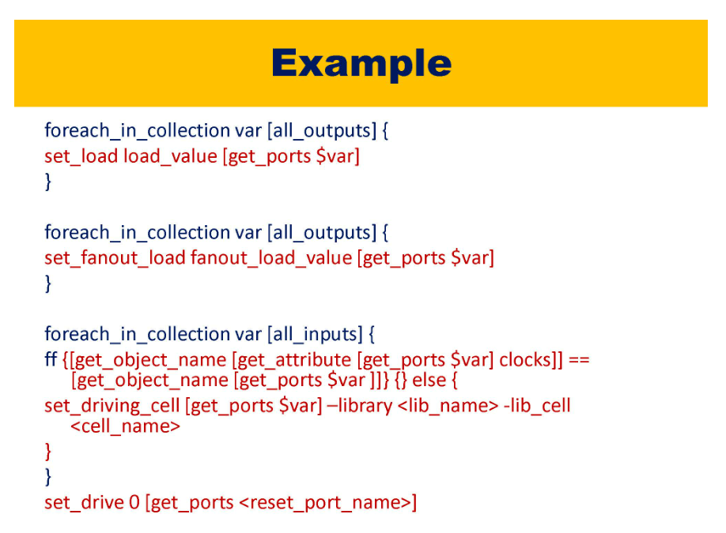

Slide 48
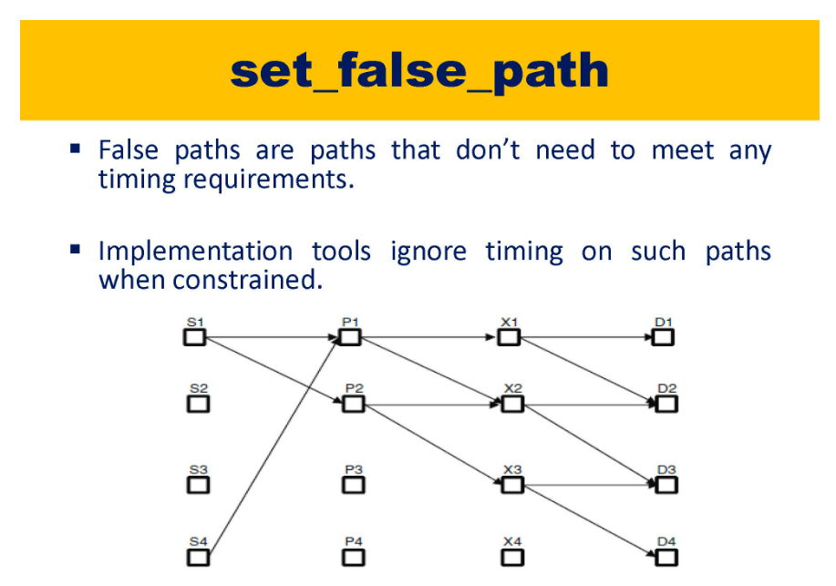

Slide 49
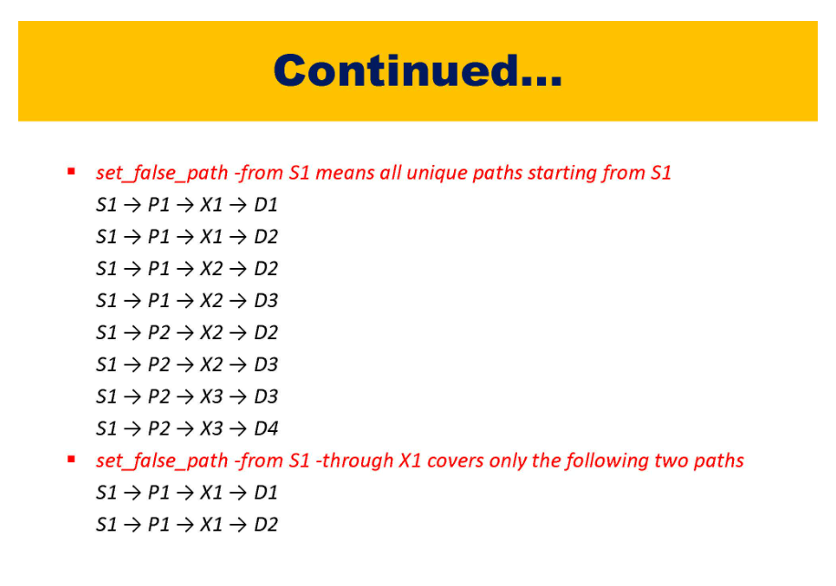

Slide 50
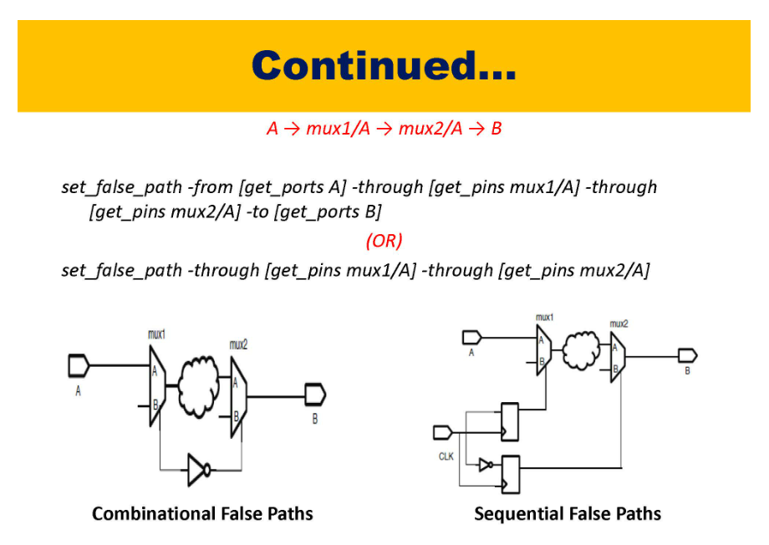

Slide 51
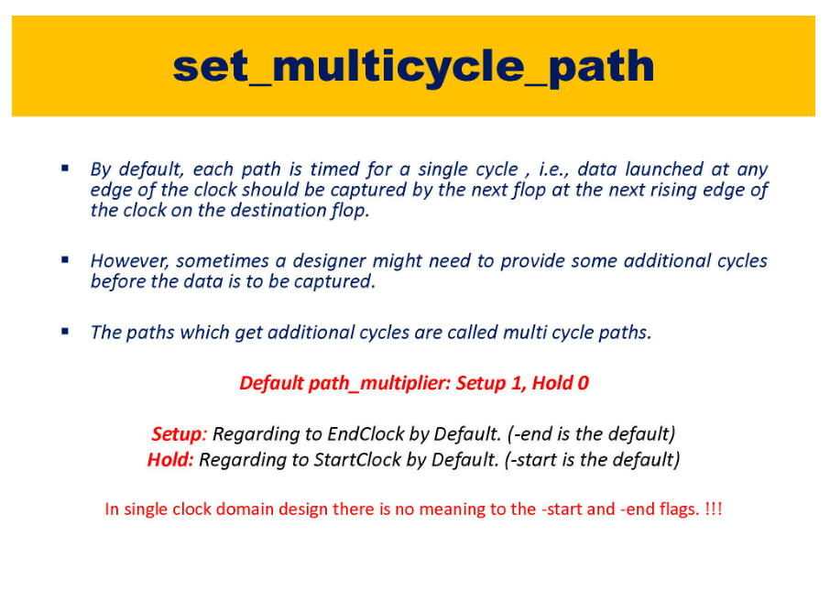
When do we define exceptions ?
1. Multi-paths. Ripple Carry adder gives result in 4 clocks. If it is taking 4 clock cycles it will take these many cycles

Slide 52


Slide 53


Slide 54


Slide 55


Slide 56


Slide 57


Slide 58


Slide 60


Slide 61


Slide 62


Slide 63


Slide 64


Slide 65


